Slide 1
CH6 Review Solving Rational Equations

Slide 2
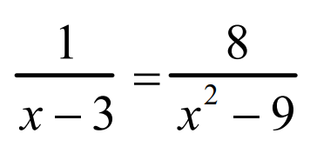
When solving this equation, what is the Lowest Common Denominator?

Slide 3
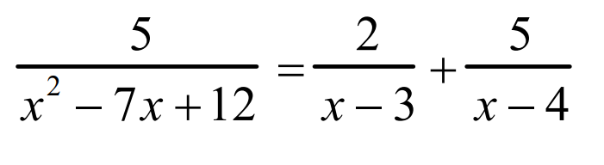
When solving this equation, what is the Lowest Common Denominator?

Slide 4
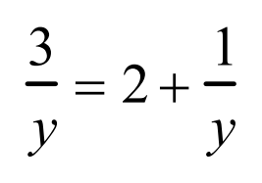
When solving the following equation, which steps have errors?
Step 1: The mistake is that the LCD is not equal to “y” but should be “2y”
Step 2: The mistake in step 2 is that you forgot to multiply one of the terms by the LCD and NOT just the terms with a denominator
Step 3: you are not supposed to cancel the denominator when solving for “x”
Step 4: Since all the variables are gone, this is an error
There is no error since the answer at the very end is correct
Solve for y:
Step 1: Find the LCD: y
Step 2: Multiply all steps by y
Step 3: Cancel all the denominators
Step 4: Combine Like Terms
Step 5: Solve for “x”

Slide 5
The work below are the steps provided by two students when solving the equation shown. Which student is correct?
Student 1 is correct because his work required less steps
Student 1 is correct because he/she simplified the expression correctly
Student 2 is correct because their work is more detailed and required more steps
Student 2 is correct because he/she simplified the expression correctly
Both students are correct because they both have the same answer

Slide 6
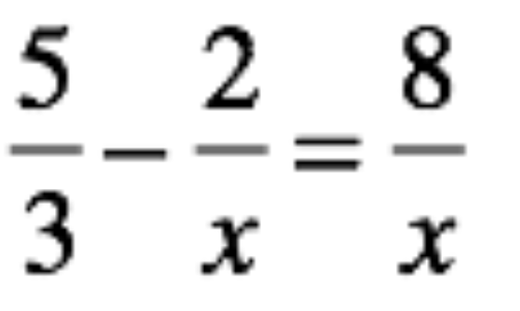
When solving this equation, which of the following is not a valid first step?
a) Move the –(2/x) to the right side to combine like terms
b) Multiply all three terms by the LCD “x”
c) Multiply all three terms by the LCD “3x”
d) Multiply all three terms by a common denominator of “3x²”
e) Guess and check a bunch of different values for “x” so that both sides will be equal

Slide 7
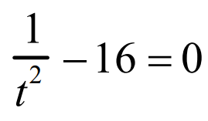
When solving the following equation, which of the following is incorrect?
Move the 16 to the right side and then square root both sides to solve for “t”
b) Factor the left side of the equation by using the difference of squares formula
c) Square root the left side of the equation and then solve for “x” algebraically
d) Multiply all terms by t² to cancel out all denominators and then solve for “x”

Slide 8
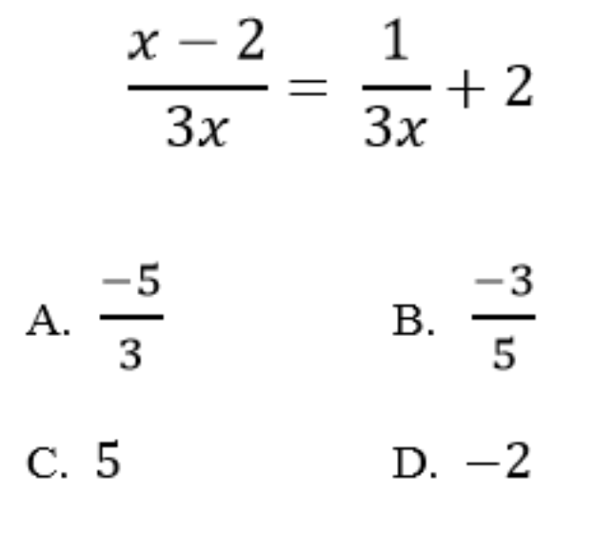
Solve for “x:

Slide 9
Q: Indicate True or False for each of the statements below:
When Multiplying Rational functions, you must have a common denominator
When Adding/Subtracting Rational functions, you must have a common denominator
When solving Rational Functions, you must have a common denominator
True or FALSE
True or FALSE
True or FALSE

Slide 10
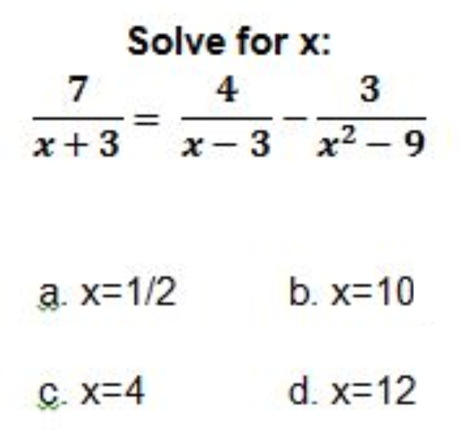

Slide 11
Add the following:

Slide 12
Subtract the following:

Slide 13
Add the following:

Slide 14
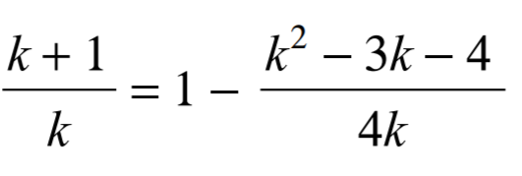
The following work was shown in solving the equation below. AT which step was the first mistake made?
a) The first mistake is in step 1
b) The first mistake is in step 2
c) The first mistake is in step 4 because terms were incorrectly cancelled out
d) The first mistake is in step 7 because one of the answer is extraneous
e) There are no mistakes in all the steps and both answers are correct

Slide 15
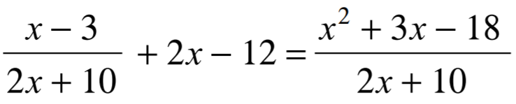
The following work was shown in solving the equation below. AT which step was the first mistake made?
a) The first mistake is in step 1, you can’t move an entire rational expr. to the opposite side
b) The first mistake is in step 3
c) The first mistake is in step 4
d) The first mistake is in step 5 because you can not cancel the binomials
e) The first mistake is in steps 7 because x=-5 is not included as one of the answers
f) There are no mistakes and all the steps are correct

Slide 16
Subtract the following:

Slide 17
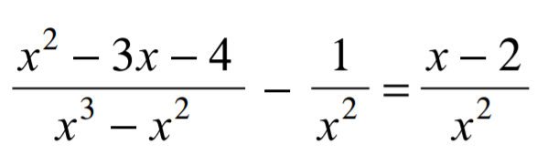
When solving the following equation, what is the LCD?

Slide 18
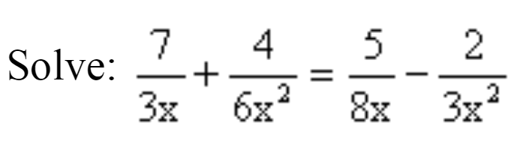
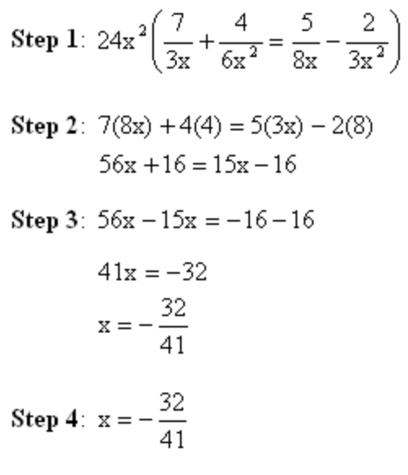

Slide 20
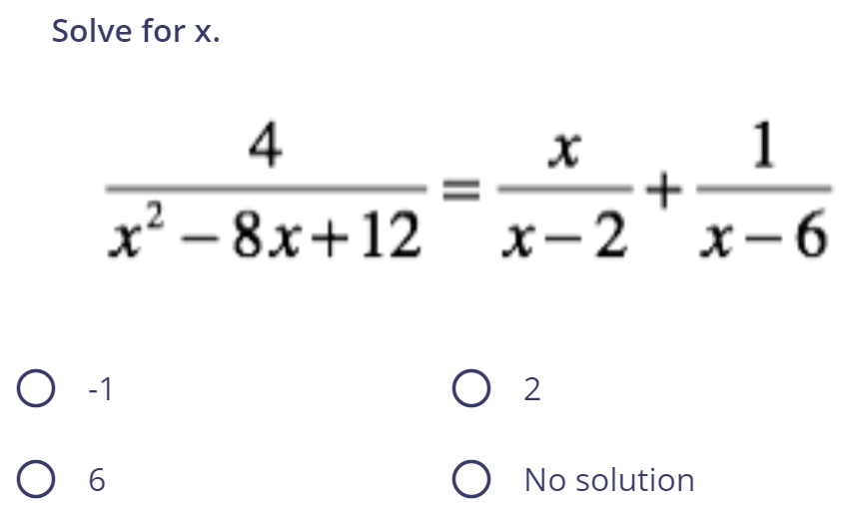

Slide 21
Add and simplify the equation below:

Slide 22
Subtract and simplify the equation below:

Slide 23
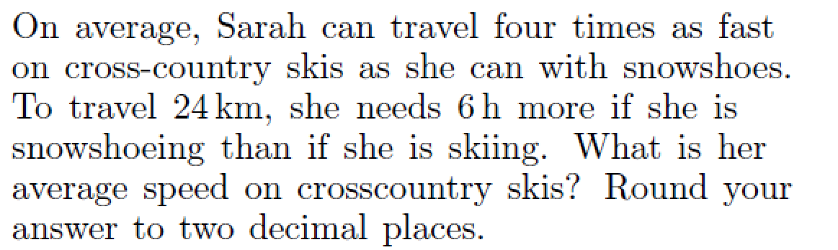

Slide 24
